Slide 1

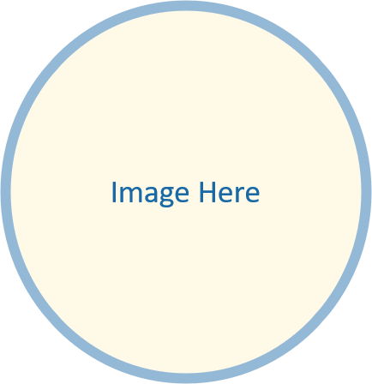


Store Sales Analysis

Slide 2


Project Idea
Brief Description
Sales data contains orders, customers, products, and regions—but extracting insights is challenging:
Identify trends: Top-performing categories and seasonal patterns
Understand performance: Customer segments and regional variations
Optimize decisions: Inventory, marketing, and resource allocation
Overview of the Proposed Solution
A data-driven dashboard will be developed to:
Visualize Key Metrics: Sales, profits, and customer behavior.
Analyze Trends: Time-based patterns, product performance, and regional comparisons.
Unique value proposition
Interactive Insights: Dynamic filters (region/category/time period)
User-Friendly Design: Intuitive for all stakeholders.

Slide 3
Project Wireframe
KPI Cards:
Total Sales
Total Orders
Total Customers
Sales Overview Panel:
Line/Area chart showing sales trends over time.
Product Insights Section:
Bar Chart: Top 5 Customers and Top 5 Sub-Categories by total sales.
Bar Chart: Sales by Sub-category (filtered by selected month).
Bar Chart: Top 12 Cities by Sales.
Customer Behavior
Sales by time of day/day of week.
Slicers Sidebar:
Month (e.g., dropdown or horizontal slicer for easier time navigation)
Sub-category (to drill down into specific product groupings)

Slide 4

End Users + Features
End Users (Primary Personas)
Sales Managers: Monitor performance, detect trends, and set targets
Business Owners: Make data-driven decisions to increase revenue
Data Analysts: Extract insights , visualize KPIs, and report findings
Key Features:
Interactive Dashboards – Visualize sales trends, top products, and regions
Real-time Sales Tracking – Monitor live performance and inventory movement
Predictive Analytics – Forecast future sales and demand
How the Features Meet User Needs:
Interactive dashboards allow sales managers to monitor key performance indicators in real-time For data analysts, automated reporting tools save time and reduce errors by eliminating the need for manual data processing

Slide 5

Data Structure
Database Architecture
Source: XLS file (9800 record x 18 columns)
Type: Relational
Balanced Dataset: Well-distributed across categories and regions
Data Types: Mixed types
Techniques Used
Descriptive statistics for summarization.
Data cleaning (e.g., handling missing values).
Exploratory analysis for trends and relationships among features.

Slide 6
Programming Languages + Frameworks
Programming Languages
Python: Used for data preprocessing, transformation, and Exploratory Data Analysis (EDA)
SQL: Employed to query structured data and extract relevant subsets
DAX (Data Analysis Expressions): Used within Power BI to create dynamic and custom metrics (KPIs, calculated columns)
Tools
Power BI (Dashboarding): Core tool for building interactive dashboards, visualizing trends, and presenting insights to stakeholders
Kaggle Notebook: Used as a collaborative environment for initial data exploration, scripting, and sharing analysis work

Slide 7

Live Application + Test
Status:
Ready for Deployment
Final visuals and metrics have been validated and optimized for performance
Data Coverage:
Sales: $2.26M total, analysed by month, sub-category, and customer segment
Orders: 9,800 total transactions, broken down by year, region, and product category
Testing Performed:
Unit Testing: Ensured accuracy of all DAX measures (e.g.,, profit, rankings)
Integration Testing:
Verified that slicers (Month & Sub-category) correctly update all related visuals and KPI cards
The dashboard is fully interactive, responsive, and aligned with business analysis goals

Slide 8
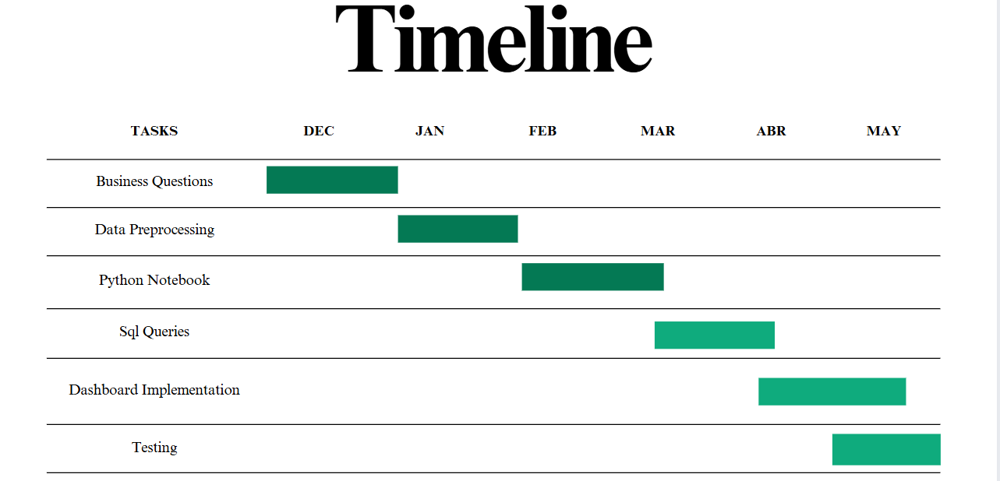
Project Deliverables
Python Notebook (Data cleaning and visualizations )
SQL Queries
Documentation
Presentation
Dashboard
Project Timeline

Slide 9

Our Team
Project Team & Responsibilities
Tarek Omar : Python Notebook
Yassin Ahmed : SQL Queries
Retaj Yasser : Dashboard (Power BI)
Eman Abdelrahim: Preprocessing (Power BI)
Collaboration Methods
Weekly Meetings
Notion

Slide 10


